Slide 1
//FILE INPUT
/*Read Values from the Input file*/
#include <stdio.h>
int main()
{
//file pointer definition to hold a disk location
FILE * fp;
fp = fopen("inputFile.txt","r");
//assign its address/disk location to file pointer
char firstWord[20];
char secondWord[20];
int num;
if(fp==NULL)
{
printf("File doesnot Exist...");
return 1;
}
printf("Reads two words and an integer from file \n");
fscanf(fp,"%s %s %d", firstWord,secondWord,&num);
printf("Display back what has been read from input file: \n");
printf("%s %s \n%d \n",firstWord,secondWord,num);
fclose(fp);
return 0;
}

Slide 2
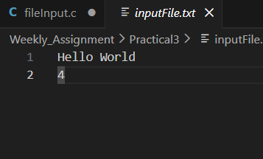
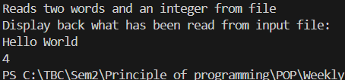
OUTPUT: File Input

Slide 3
What are the differences between these two blocks of
code?
: The fscanf() function takes input from the txt file
: The scanf() function takes input from the users.

Slide 4
//READ ELECTRICITY BILL
#include <stdio.h>
int main()
{
FILE * fp;
int a,b,c,d;
fp = fopen("bill_input.txt","r");
if(fp==NULL)
{
printf("File doesnot Exist...");
return 1;
}
printf("Reading Values from bill input \n");
fscanf(fp,"%d %d %d %d",&a,&b,&c,&d);
printf("Displaying file: \n");
printf("%d %d %d %d\n\n",a,b,c,d);
// Goes (starts) to the beginning of the file
fseek(fp,0,SEEK_SET);
for (int i=1;i<=7;i++)
{
fscanf(fp,"%d %d %d %d",&a,&b,&c,&d);
printf("%d %d %d %d\n",a,b,c,d);
}
fclose(fp);
return 0;
}

Slide 5
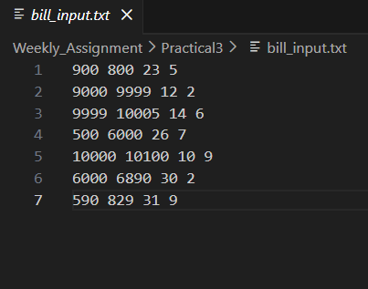
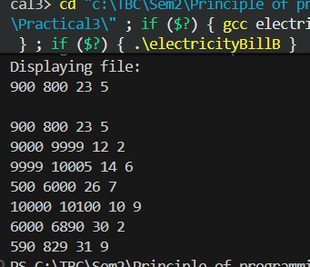
OUTPUT: READ ELECTRICITY BILL

Slide 6
//Customer Statistics Pseudo Code
/*
Step 1: Start
Step 2: Open file
Step 3: Take input from the file
Step 4: If about 1000 heave user,
else if 500-100 unit consumed regular user
below 0-500 unit consumed light user
else, should enter [positive integer(more than 0)
Step 5: Count the unit consumer
Step 6: Display the number of consumer, classifiying the users
Step 7: End
*/

Slide 7
//Customer Statistics
#include <stdio.h>
int main()
{
FILE * fp;
int unit,test_int;
int count_huser=0, count_ruser=0, count_luser=0;
fp = fopen("testInput.txt","r");
if(fp==NULL)
{
printf("File doesnot Exist...");
return 1;
}
//takes input from the file unit it reaches the end of file
while((test_int=fscanf(fp,"%d",&unit))!=EOF)
{
if (unit>=1000)
{
count_huser+=1;
}
else if (unit>=500 && unit<1000)
{
count_ruser+=1;
}
else if (unit>0 && unit<500)
{
count_luser+=1;
}
else
{
printf("Invalid Input!!");
}
}
printf("\nHeavy Users :%d\n",count_huser);
printf("Regular Users :%d\n",count_ruser);
printf("Light Users :%d\n",count_luser);
fclose(fp);
return 0;
}

Slide 8
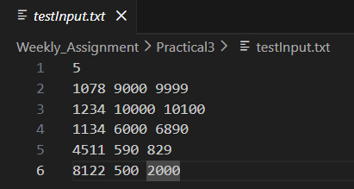
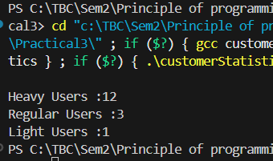
Output: Customer Statistics

Slide 9
Display Pattern:
#include <stdio.h>
//PATTERNS
int main ()
{
int size = 6;
//using temp as copy variable of size to not affect the actual size variable
int temp = size;
int temp2 = size;
to be continued…

Slide 10
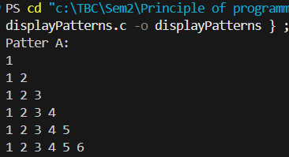
Display Pattern: Pattern A
printf("Patter A: \n");
for(int i=1;i<=size;i++)
{
for (int j =1;j<=i;j++)
{
printf("%d ",j);
}
printf("\n");
}
printf("\n\n");
OUTPUT:
to be continued…

Slide 11
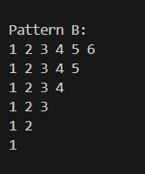
Display Pattern: Pattern B
printf("Pattern B: \n");
for(int i=1;i<=size;i++)
{
for(int j =1; j<=temp;j++)
{
printf("%d ",j);
}
temp-=1;
printf("\n");
}
printf("\n\n");
OUTPUT:
to be continued…

Slide 12
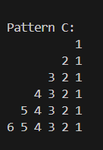
Display Pattern: Pattern C
printf("Pattern C: \n");
for(int i=1;i<=size;i++)
{
for(int space =i;space<size;space++)
{
printf(" ");
}
//reversing the pattern
for(int j=i; j>=1;j--)
{
printf("%d ",j);
}
//temp2-=1;
printf("\n");
}
printf("\n\n");
OUTPUT:
to be continued…

Slide 13
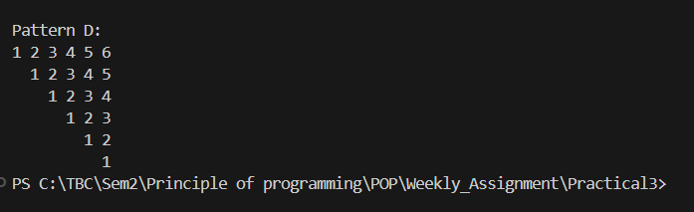
Display Pattern: Pattern D
printf("Pattern D: \n");
for(int i=1;i<=size;i++)
{
for(int space=1;space<i;space++)
{
printf(" ");
}
for(int j = 1;j<=temp2;j++)
{
printf("%d ",j);
}
temp2-=1;
printf("\n");
}
return 0;
}
OUTPUT:

Slide 14
//Largest num, count
#include <stdio.h>
int main()
{
FILE * fp;
fp = fopen("occurrence.txt","r");
int size = 10,num[size], largest=num[0];
int l_occurrence =0;
if (fp==NULL)
{
printf("File doesnot exist");
return 1;
}
//Reading values from file
for(int i =0;i<size;i++)
{
fscanf(fp,"%d",&num[i]);
//Assuming input ends with 0
//breaks if input is 0 while fetching
if(num[i]==0)
{
break;
}
if (largest<num[i])
{
largest = num[i];
}
}
to be continued…

Slide 15
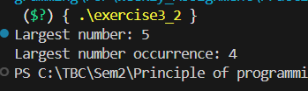
… Largest num, count (continued)
printf("Largest number: %d\n",largest);
printf("Largest number occurrence: %d\n",l_occurrence);
fclose(fp);
return 0;
}
//counting the occurrence of largest number
for(int j = 0; j<size;j++)
{
if(num[j]==0)
{
break;
}
if(largest== num[j])
{
l_occurrence+=1;
}
}
OUTPUT:

Slide 16
Vowel and Consonant Count
#include <stdio.h>
int main()
{
int t_vowel=0, t_consonants=0;
char str[100];
// To compare sentence with vowel letter
char vowel[10]= {'a','e','i','o','u','A','E','I','O','U'};
printf("Enter a word : ");
// Takes (reads) input until user enters new line.
scanf("%[^\n]",str);
/*loops runs if the string is not null char
as string ends with null character when it reaches
last array(null char) loop ends*/
for (int i =0; str[i]!='\0';i++)
{
//checks whether the given input is alphabet or not
//done so to not count space in total consonant
if(str[i]>='A' && str[i]<='Z' || str[i]>='a' && str[i]<='z')
{
// the given input is not vowel, resets after each letter
int is_vowel =0;
for(int j =0; j<10;j++)
{
if(str[i]==vowel[j])
{
// if the given input is vowel
is_vowel =1;
}
}
to be continued…

Slide 17
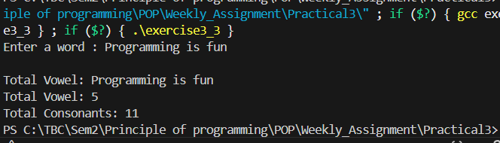
… Vowel and Consonant Count continued
if (is_vowel==1)
{
t_vowel+=1;
}
if (is_vowel == 0)
{
t_consonants+=1;
}
}
}
printf("\nTotal Vowel: %s",str);
printf("\nTotal Vowel: %d\n",t_vowel);
printf("Total Consonants: %d",t_consonants);
return 0;
}
OUTPUT:

